Slide 1
Dimensionality reduction in subsurface modeling
June 13, 2022
Misael M. Morales
Graduate Research Assistant, The University of Texas at Austin
Dr. Michael Pyrcz
Associate Professor, The University of Texas at Austin
Dr. Carlos Torres-Verdin
Professor, The University of Texas at Austin

Slide 2
Executive Summary
Accurate and detailed subsurface models are often too large and/or redundant for practical data science applications.
Dimensionality Reduction is an efficient theme for modeling and simulation of the subsurface, exploiting the hidden features and information in data.
1) We survey different dimensionality reduction techniques, and their usage for subsurface modeling – testing their power for reconstructing subsurface images from reduced dimensional space.
2) We built a forward simulator for CO2 monitoring using a deep learning architecture that exploits the latent space dynamics.
We recommend to work in latent space for subsurface modeling, characterization, and simulation.
Workflows including history matching, closed-loop reservoir management, and robust optimization can be improved by exploiting the latent space.
2

Slide 3
Executive Summary
Motivation
PART I: Dimensionality Reduction Techniques
Part II: Hybrid CNN-RNN for CO2 Monitoring
Conclusion
Outline
3

Slide 4
Motivation
4

Slide 5
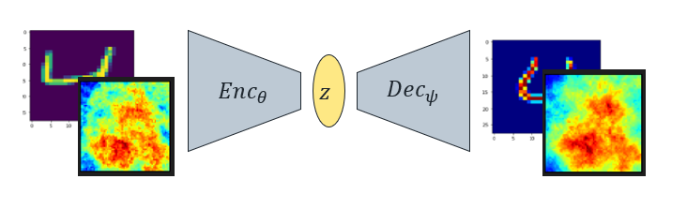
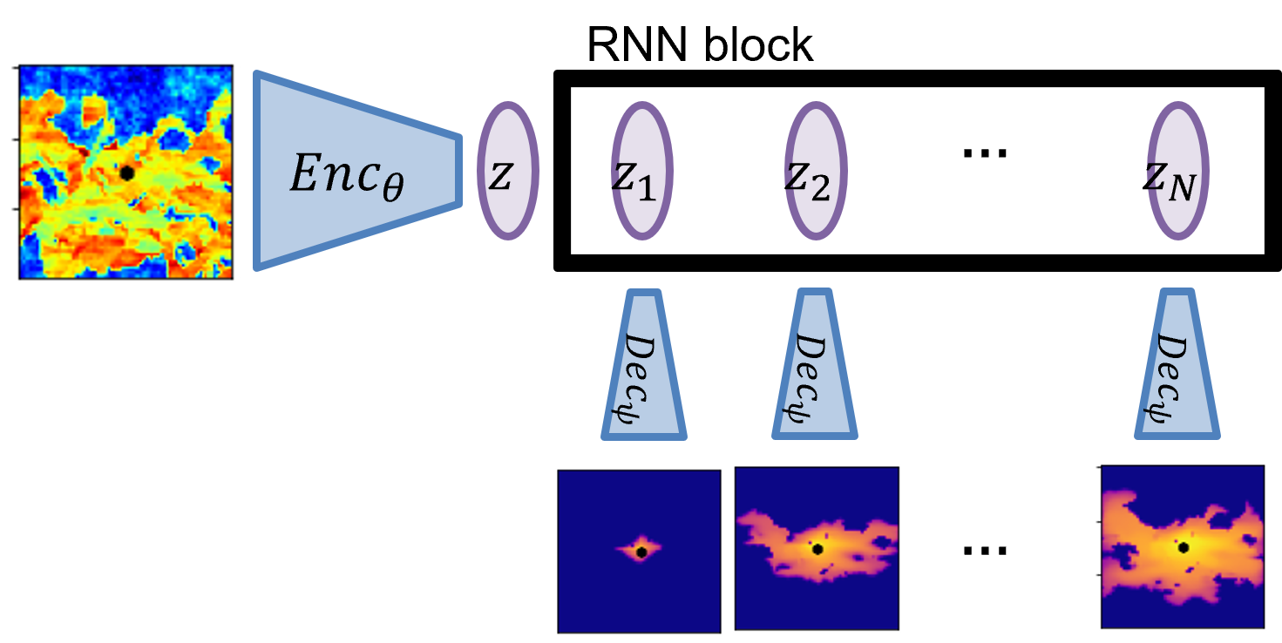
Subsurface spatial data is often very large, and different sources and scales make it difficult to process.
There tends to be a high degree of correlation and structure in 2D/3D subsurface data, which makes it a perfect candidate for latent space analysis and modeling.
Encoder-Decoder architectures allow for efficient latent representation and analysis of subsurface data.
We propose:
A survey of different dimensionality reduction techniques and applications to generic and subsurface data.
A hybrid CNN-RNN proxy model for CO2 monitoring, exploiting latent space dynamics.
AutoEncoders for Dimensionality Reduction
CNN-RNN for CO2 Monitoring
5
Notes:
Why we need dimensionality reduction in subsurface modeling
Why encoder-decoder architectures are best
- Project 1: An overview of different dimensionality reduction techniques (classic and modern) and their application to a subsurface dataset
- Project 2: An application of a deep learning-based proxy model that uses latent space dynamics for predicting CO2 migration in the subsurface

Slide 6
Recent Literature
Maldonado-Cruz & Prycz, (2022) J Pet. Sci. Eng.:
U-Net for surrogate flow model under geologic uncertainty
Generate saturation maps based on different PV injected from the permeability/porosity realizations
Jo, Pan, Santos, Jung & Pyrcz, (2021) J Pet. Sci. Eng.:
Machine learning-assisted history matching
Using GAN for automatic history matching of deepwater lobe systems
Alakeely & Horne, (2020) SPE Res. Eval. Eng.:
Deep learning models for downhole signal predictions
Comparison of CNN and RNN for the prediction of downhole rates, pressure, choke setting, etc.
Kim & Durlofsky, (2022) ArXiV:
CNN-RNN for robust optimization and closed-loop management
CNN-LSTM architecture from to predict production rates from permeability maps
Kaur, Fomel, et. al., (2022) GeoSci World Interpretation:
Seismic Inversion via CNN-RNN architecture
Used a CNN-Transformer architecture to predict permeability from seismic response (forward=perm->sat->seismic)
6
Notes:
Recent advances in Deep Learning applications in petroleum engineering and subsurface modeling (as well as seismic reservoir characterization/inversion)
None have developed image-to-image (or image-to-timelapse images) deep learning proxy! Nor applied it to CO2 monitoring!

Slide 7
PART I
Dimensionality Reduction Techniques
SVD, PCA, Dictionary Learning, FFT & Wavelet, Deep Learning
AutoEncoders for Dimensionality Reduction
7

Slide 8
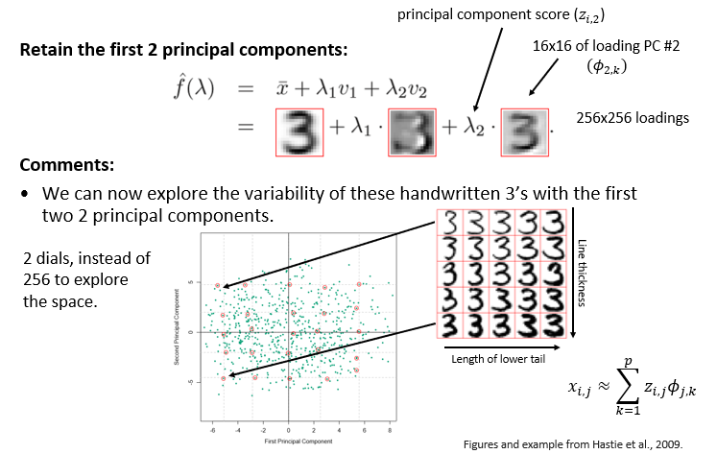
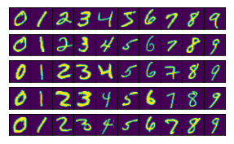
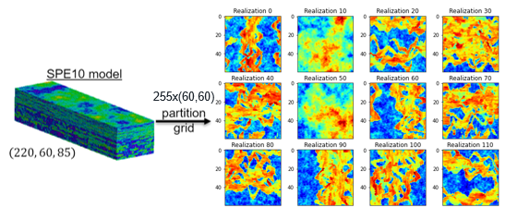
Subsurface Dimensionality Reduction
Similar architectures from MNIST examples, applied to SPE10 data.
Applications to geologic scenario selection, robust optimization, uncertainty quantification, inverse modeling, …
MNIST dataset – 60,000x(28,28)
SPE10 data generation process
8
Notes:
All models/techniques are first tested on the MNIST/digits dataset.
Then, we use a preprocessed SPE10 dataset to apply the dimensionality reduction technique to subsurface data!
All is performed using the encoder-decoder architecture that exploits latent space information.

Slide 9
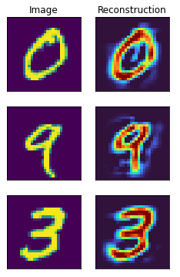
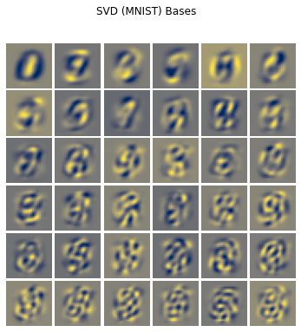
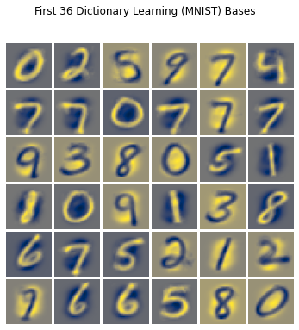
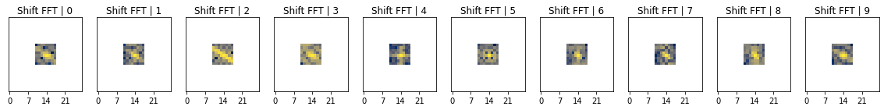
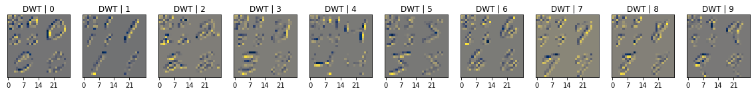
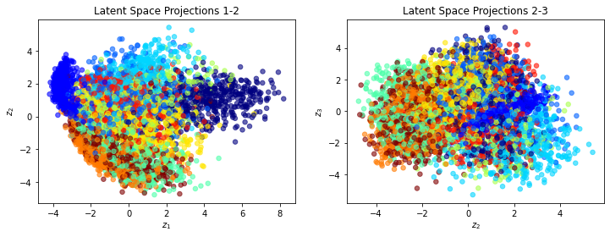
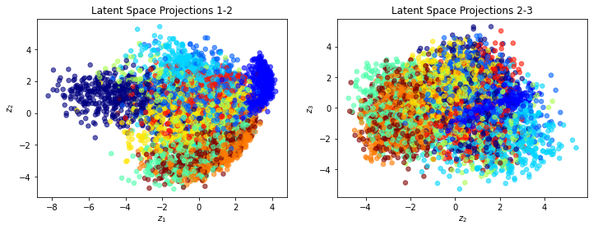
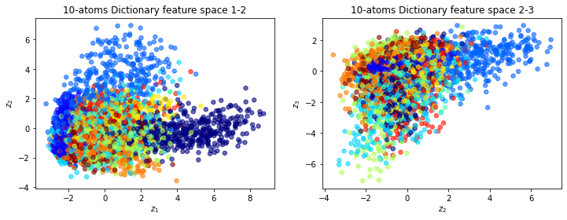
MNIST Example
Classical dataset for image processing.
Demonstrate the usage of each dimensionality reduction technique with MNIST first.
Principal Component Analysis
Singular Value Decomposition
Dictionary Learning
Discrete Fourier Transform
Discrete Wavelet Transform
9

Slide 10
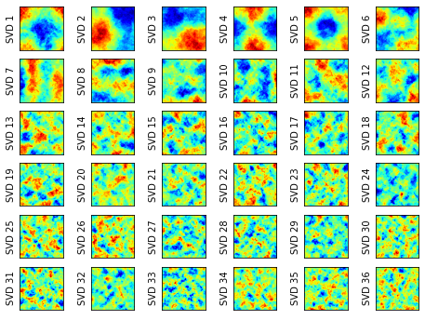
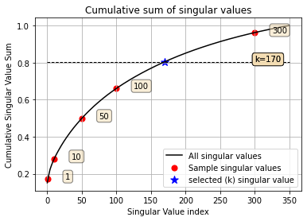
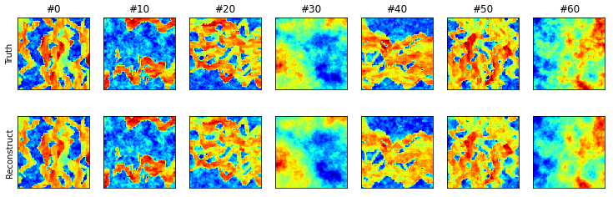
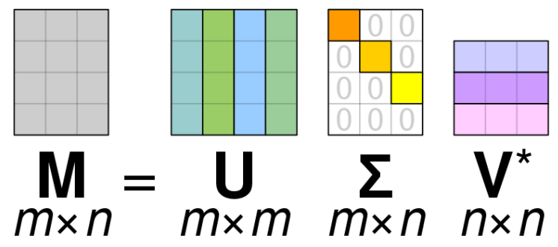
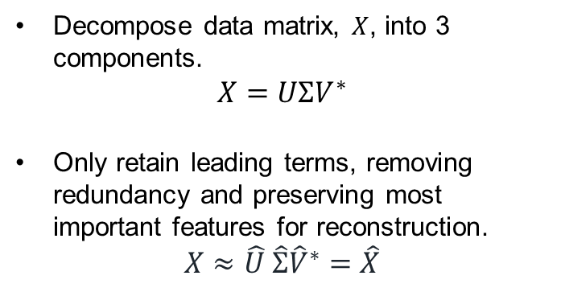
170 SV’s retained
MSE=0.003
SSIM=0.970
SVD
Decompose data matrix, $X$, into 3 components.
$$X=UΣV^{∗}$$
Only retain leading terms, removing redundancy and preserving most important features for reconstruction.
$$X≈\hat{U} \hat{Σ}{\hat{V}}^{∗}=\hat{X}$$
First 36 SVD basis
From Wikipedia, SVD
Original (top) and SVD-reconstructed (bottom) realizations
10
Notes:
SVD is one of the most classical techniques.
It decomposes the data (X) into left-singular-vector (U), singular values (S), and right-singular-vectors (V^T).
170 leading basis for the SVD representation of the SPE10 data, and the reconstruction of the models using the leading SVD’s

Slide 11
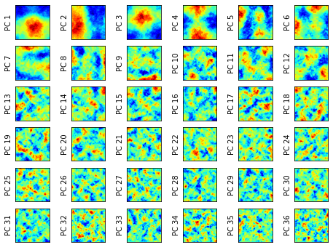
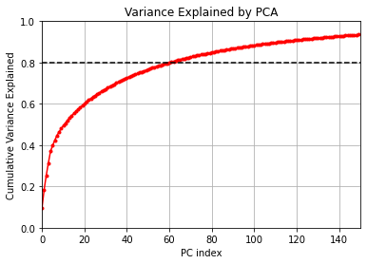
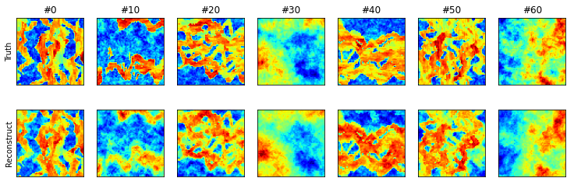
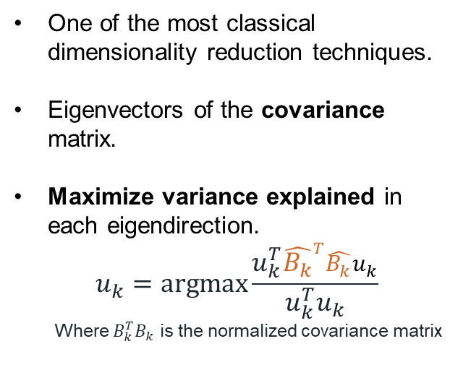
80 PC’s retained
MSE=0.010
SSIM=0.873
PCA
One of the most classical dimensionality reduction techniques.
Eigenvectors of the covariance matrix.
Maximize variance explained in each eigendirection.
$$u_{k}=\operatorname{argmax}{\frac{u_{k}^{T}{\hat{B_{k}}}^{T}\hat{B_{k}}u_{k}}{u_{k}^{T}u_{k}}}$$
Where $B_{k}^{T}B_{k}$ is the normalized covariance matrix
First 36 PCA basis
Original (top) and PCA-reconstructed (bottom) realizations
11
Notes:
PCA is the second most classical technique
PCA basis for the SPE10 model, using only the leading 80 PC’s. And the reconstruction of the models from these leading terms.

Slide 12
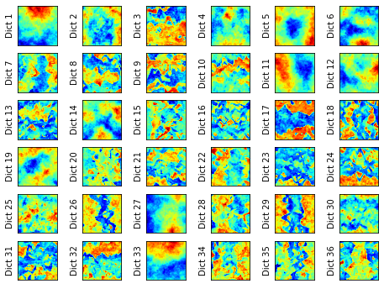
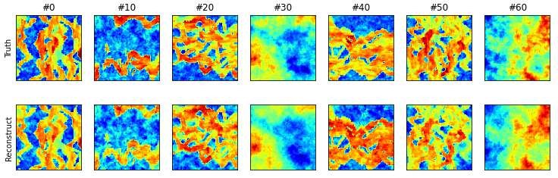
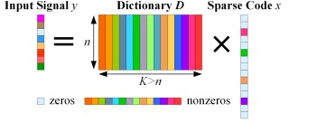
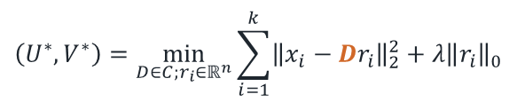
Dictionary Learning
Exploit sparsity in the representation of data by generating a “dictionary” of “words” that we can combine to reconstruct images.
Uses the K-SVD algorithm to iteratively find the best words/atoms and the best sparse coder to represent the data.
120-atom dictionary
MSE=0.005
SSIM=0.934
First 36 Dictionary atoms/words
$$\left(U^{∗},V^{∗}\right)=\min_{D∈C;r_{i}∈ℝ^{n}}{\sum_{i=1}^{k}{{\left\|x_{i}−Dr_{i}\right\|}_{2}^{2}+λ{\left\|r_{i}\right\|}_{0}}}$$
From Kong, et. al. (2020)
Original (top) and Dictionary Learning-reconstructed (bottom) realizations
12
Notes:
If we have a Dictionary of words/atoms that can accurately represent the data, and a Sparse Coder that can point to where we can select the correct words/atoms, then we can reconstruct any model using the combination of words/atoms and codes.
SPE10 leading atoms and reconstruction using a dictionary of only 120 atoms.

Slide 13
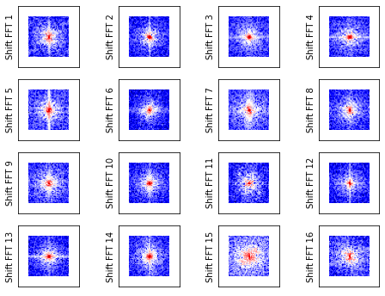
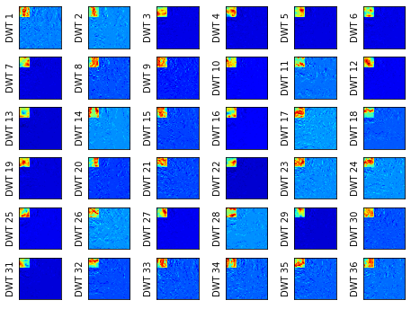
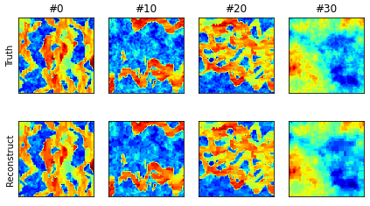
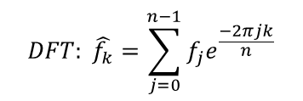
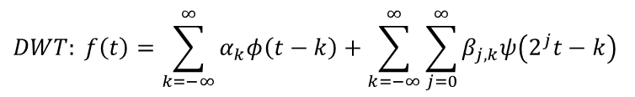
$$DFT: \hat{f_{k}}=\sum_{j=0}^{n−1}{f_{j}e^{\frac{−2πjk}{n}}}$$
$$DWT: f\left(t\right)=\sum_{k=−∞}^{∞}{α_{k}φ\left(t−k\right)}+\sum_{k=−∞}^{∞}{\sum_{j=0}^{∞}{β_{j,k}ψ\left(2^{j}t−k\right)}}$$
Fast Fourier Transform
40% retained
MSE=0.003 | SSIM=0.965
Wavelet Transform
30% retained
MSE=0.001 | SSIM=0.989
FFT & Wavelet
Leading techniques for image/video compression.
FFT:
Generic basis of sines/cosines from eigenvectors.
Retains frequencies
DWT:
Multiresolution information
Spatiotemporal / localized analysis via adaptive filtering bands .
First 8 FFT representations
First 8 DWT representations
Original (top) and FFT-reconstructed (bottom) realizations
Original (top) and DWT-reconstructed (bottom) realizations
13
Notes:
FFT and DWT are the leading techniques for image/video compression (JPEG, etc.)
FFT uses a generic basis of sines/cosines from the eigenvectors to represent the data. It retains a range of frequencies from the original image. Data is shifted from time-space to frequency-wavenumber domain.
DWT uses generic basis of sines/cosines, but it exploits multiresolution information for spatiotemporal analysis, using adaptive filtering of frequency bands for localized information.
SPE10 FFT/DWT basis for the first few samples. Also, the original and reconstructed images retaining only a percentage of the latent space.

Slide 14
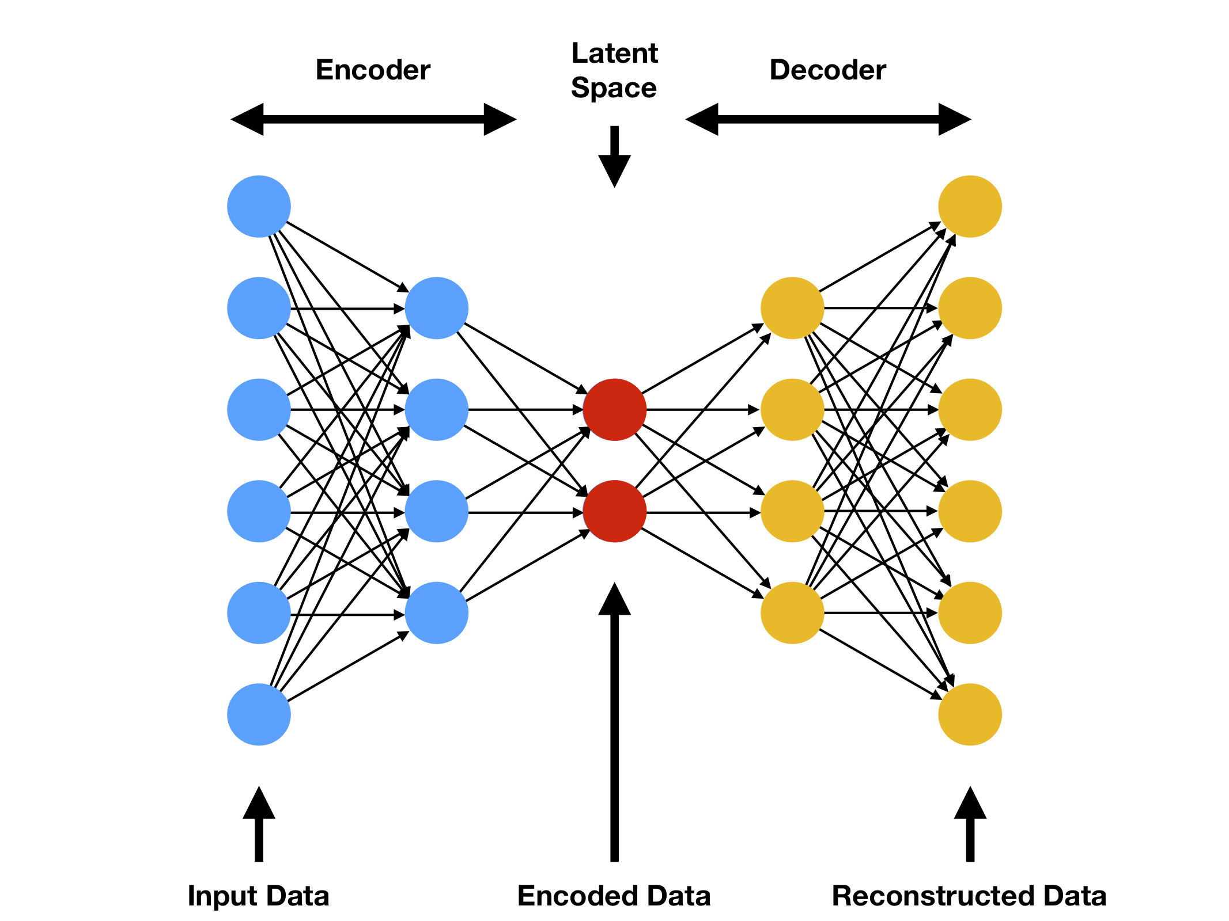
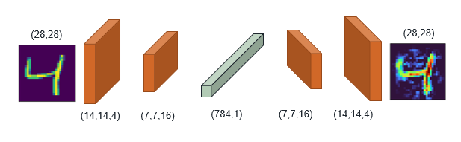
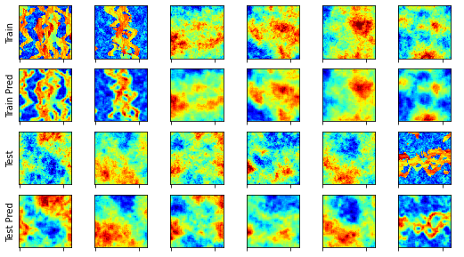
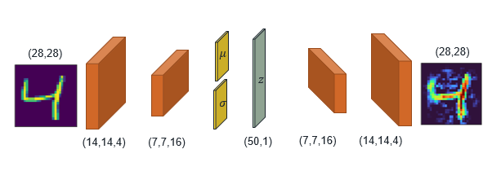
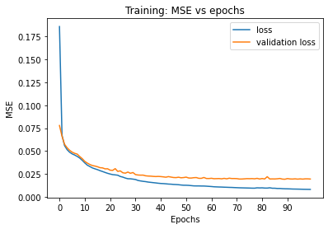
From compthree.com/blog/autoencoder/
Deep Learning
50
Train:
MSE=0.011
SSIM=0.867
Test:
MSE=0.021
SSIM=0.736
MNIST flat
MNIST reconstruct
784
100
100
784
FCNN-AE architecture
CNN-AE architecture
CNN-AE training process
CNN-VAE architecture
CNN-VAE Train/Test Truth & Predictions
14
Notes:
Deep Learning is very powerful for dimensionality reduction.
A lot of different architectures can be designed (Fully-Connected, Convolutional, Variational, etc.)
3 examples of “vanilla” networks to encode-decode the SPE10 data.
Note: These can be significantly improved with a lot more detailing and fine-tuning, but for this purpose, we just demonstrate the applicability and power of these techniques.

Slide 15
PART II
Hybrid CNN-RNN for CO2 Monitoring
CNN-RNN architecture
15

Slide 16
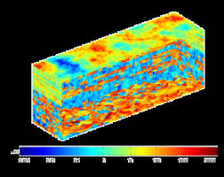



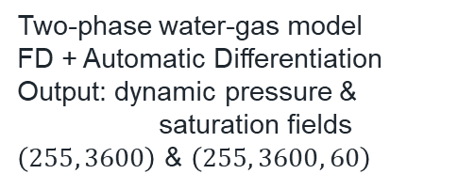
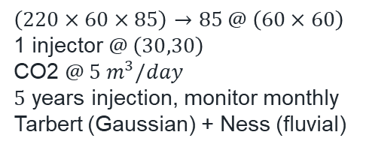
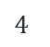
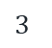
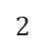

Develop a deep learning framework for forward reservoir simulation of CO2 migration
Exploit latent space dynamics for timelapse predictions using a CNN-RNN architecture
$$1$$
Reservoir Model
(SPE10)
$$\left(220×60×85\right)→85 @ \left(60×60\right)$$
1 injector $@ \left(30,30\right)$
CO2 $@ 5 m^{3}/day$
$5$ years injection, monitor monthly
Tarbert (Gaussian) + Ness (fluvial)
$$3$$
Data Processing
(Python)
Reshape to images
Data augmentation (rotation)
Random Shuffling
Min-Max Normalization
Train/Test split
$$2$$
Numerical Simulation
(MRST)
$$4$$
Deep Learning
(Keras)
Encoder: Conv2D
Recurrent: GRU
Decoder: Conv3DTranspose
Compile, Fit & Predict
Two-phase water-gas model
FD + Automatic Differentiation
Output: dynamic pressure & saturation fields
$\left(255, 3600\right)$ & $\left(255, 3600, 60\right)$
16
Notes:
This project is composed of 4 main parts (reservoir model, numerical simulation, data processing, and the deep learning-based proxy model
The proxy model is CNN-RNN-CNN encoder-decoder structure that exploits latent space dynamics to model a timelapse of saturation from a static permeability input.

Slide 17
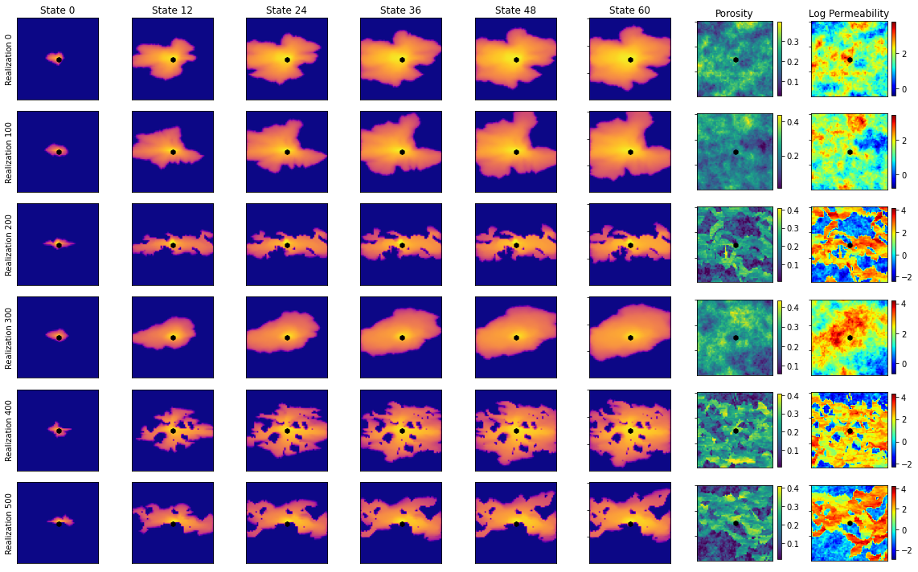
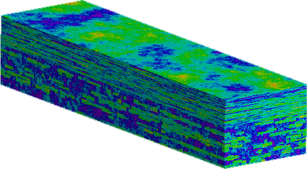


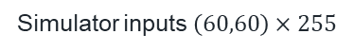


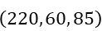

1. Reservoir Model
SPE10 model
partition
grid
reservoir
simulation
$$\left(220, 60, 85\right)$$
Simulator inputs $\left(60,60\right)×255$
Timelapse saturation states
$$\left(220, 60, 85\right)$$
Full SPE10 model
(60,60)
Permeability
(60,60,60)
Saturation
$$\left(60, 60, 255\right)$$
ML forward proxy
CNN-RNN
Proxy
$$\left(60, 60, 85\right)$$
$$\left(60, 60, 85\right)$$
$$\left(60, 60, 85\right)$$
Partitioned SPE10 model
17
Notes:
Data comes from SPE10
We partition the 220x60x85 model into 255 x (60,60) realizations and use MRST to forward-simulate CO2 injection. We collect 60 saturation states (60 months) for each realization

Slide 18
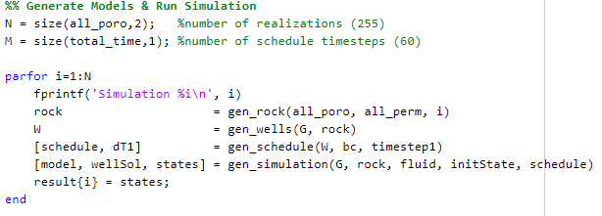
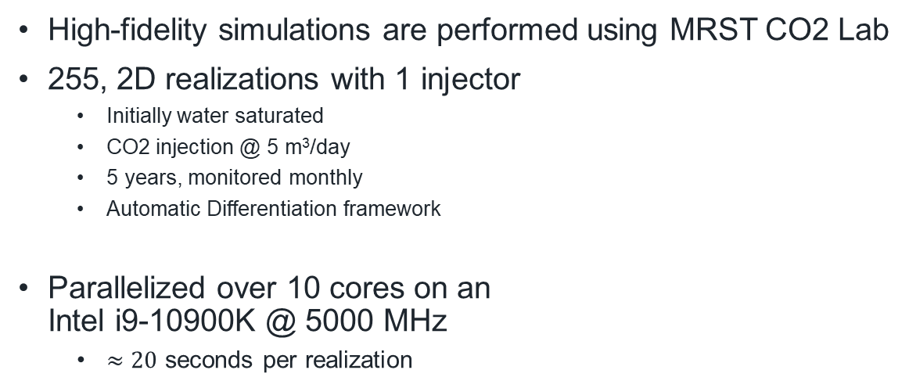
2. Numerical Simulation
High-fidelity simulations are performed using MRST CO2 Lab
255, 2D realizations with 1 injector
Initially water saturated
CO2 injection @ 5 m³/day
5 years, monitored monthly
Automatic Differentiation framework
Parallelized over 10 cores on an Intel i9-10900K @ 5000 MHz
$≈20$ seconds per realization
CO2-Brine relative perm curves
MRST simulator code
HFS input and outputs
18
Notes:
Numerical simulation is done using MRST (in parallel)
CO2Lab module in MRST provides a simplified model for CO2 injection. We use most of the default parameters for CO2 properties
Inject for 5 years, monitored monthly (60 states)
Inject 5 m^3 per day
One injector in the center

Slide 19
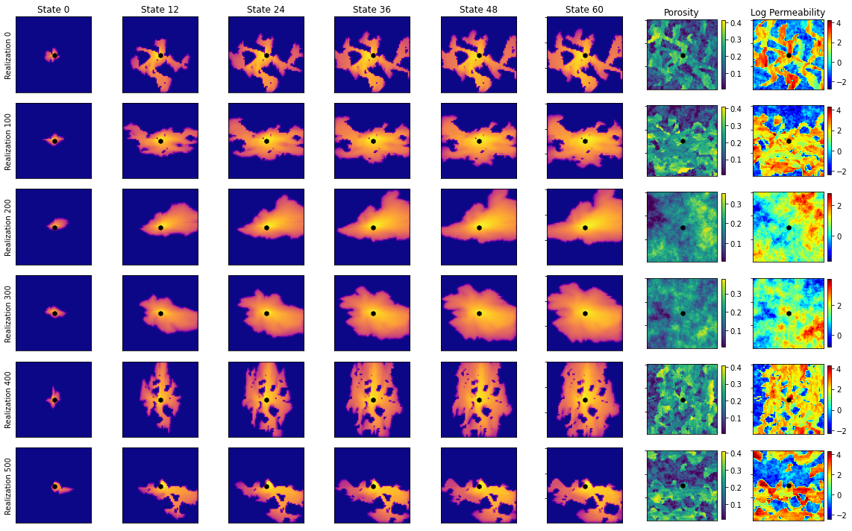
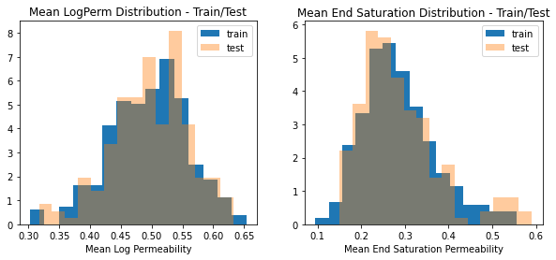

3. Data Processing
HFS sliced into $x⟹\left[perm\right]$ and $y⟹\left[saturation\right]$
Reshape to $x⟹\left[2D images\right]$ and $y⟹\left[3D \text{videos}\right]$
Data augmentation by $90°$ rotation $→510$ realizations
Shuffle concatenated dataset
Make proxy agnostic to orientation, learn true flow physics
Min-Max Normalization
Train (66%), Test (33%) random split
Augmented permeability & saturation data
Train/Test distribution for mean input & output
19
Notes:
Data from MRST is then pre-processed in order to have better machine learning
6 preprocessing steps

Slide 20


4. CNN-RNN Proxy
Encoder-recurrent-decoder architecture to predict dynamic saturation states from permeability
unfold
Folded CNN-RNN architecture
Unfolded CNN-RNN architecture
20
Notes:
Schematic of the CNN-RNN model
Left = “Folded” model, where we clearly see the encoder-recurrent-decoder architecture
Right = “Unfolded” model, where we can visualize the latent space dynamics, meaning that the latent vector is expanded into 125 features (5,5,5), and updated according to the saturation map (60,60,60)

Slide 21













CNN-RNN
architecture
4. CNN-RNN Proxy
The Encoder
Convolutional block
$$Enc_{θ}$$
$$z$$
$$\left(None, 60, 60, 1\right)$$
$ℓ_{2}$ regularization
$filters=N_{f}$
$kernel=\left(3,3\right)$
$padding=same$
Conv Block 1
Conv Block 2
LeakyReLU activation
$$N_{f}=8$$
Conv2D
Conv2D
BatchNorm
LeakyReLU
MaxPool2D
Conv Block 3
Conv Block 4
$$N_{f}=16$$
$$\left(None, 3, 3, 64\right)$$
$$N_{f}=32$$
$$N_{f}=64$$
$$\frac{N_{x}}{2},\frac{N_{y}}{2}, 2N_{c}$$
$$N_{x}, N_{y}, N_{c}$$
21
Notes:
Encoder section
Contains 4 convolutional blocks
Each convolutional block has Conv2D(LeakyRelu)-Conv2D(l2norm)-BatchNorm-LeakyReLu-MaxPool --- the pooling reduces dimensions

Slide 22










CNN-RNN
architecture
4. CNN-RNN Proxy
The Recurrent block
$$\left(None, 3, 3, 64\right)$$
Flatten
Recurrent block
Flatten
RepeatVector
GRU
Reshape
RepeatVector
GRU
Reshape
$$\left(None, 125, 576\right)$$
$$\left(None, 5, 5, 5, 128\right)$$
$$\left(None, 125, 128\right)$$
$$3, 3, 64$$
$$5, 5, 5, 128$$
$$dropout$$
$$return$$
$$sequences$$
22
Notes:
Recurrent section
We flatten the latent space, Z (576)
Repeat it 125 times
Apply recurrent layer (GRU, many-to-many) such that (125,576)->(125,128)
Reshape into (5,5,5128) … (length, width, height, channels)

Slide 23












CNN-RNN
architecture
4. CNN-RNN Proxy
The Decoder
$$\left(None, 5, 5, 5, 128\right)$$
Transpose Convolutional block
$ℓ_{2}$ regularization
$filters=N_{f}$
$kernel=\left(3,3,3\right)$
$padding=same$
ConvT Block 1
ConvT Block 2
LeakyReLU activation
ConvT3D
ConvT3D
ConvT3D
BatchNorm
LeakyReLU
$$N_{f}=64, stride=1$$
ConvT Block 3
$$N_{f}=32, stride=N_{s}$$
Output Block
$$N_{f}=16, stride=1$$
$$\left(None, 60, 60, 60, 1\right)$$
$$2N_{x}, 2N_{y}, 2N_{z},\frac{N_{c}}{N_{s}}$$
$$N_{x}, N_{y}, N_{z},N_{c}$$
$$Stride=1$$
$$Stride=N_{s}$$
23
Notes:
Decoder section
Contains 3 Transpose-Convolutional blocks, and an Output block
Each transpose convolutional block has ConvT3D(LeakyRelu)-ConvT3D(LeakyRelu)-ConvT3D(l2norm)-BatchNorm-LeakyReLu ---- the strides increase dimensions

Slide 24




CNN-RNN
architecture
4. CNN-RNN Proxy
Compile
Optimizer = Nadam (Adam with Nesterov Momentum)
$ℒ=α×\left(1−SSIM\right)+β×MSE$
Fit
Epochs = 300
Batch Size = 40
Validation split = 0.25
17 minutes on Nvidia RTX 3080
CNN-RNN Training process
24
Notes:
We then compile and fit the model
We use Nadam, Nesterov Adam. A slight update in the momentum calculation. Works better than Adam for this problem (very small learning rate)
Use a Loss function that combines MSE (pixel-wise) and SSIM (overall image)
SSIM ~ luminance, contrast, perceptual information
Overfit! ☹

Slide 25

4. CNN-RNN Proxy
CNN-RNN
architecture
Training: MSE=0.016 | SSIM=0.817
Training samples
Training inputs
Training predictions
25
Notes:
Training predictions
Very good!

Slide 26

4. CNN-RNN Proxy
CNN-RNN
architecture
Testing: MSE=0.040 | SSIM=0.563
Testing samples
Testing inputs
Testing predictions
26
Notes:
Testing Predictions
Not so good, but still useful. Can be improved!

Slide 27



Results
HFS $→$ 20 seconds per realization
RNN-CNN architecture: $\sim$930,000 parameters
0.5 milliseconds per realization $⟹$ 40,000$×$ speedup
Applications:
Uncertainty quantification
Inverse modeling
History matching / model calibration
Closed-loop / Robust optimization
Other areas:
Groundwater flows
Contaminant transport
Hydrocarbon production
CNN-RNN for latent-space history matching
CNN-RNN for inverse modeling
27
Notes:
Significant speedup in the forward simulation
Architecture can be used for other applications

Slide 28
Conclusion
28

Slide 29
Conclusion
Subsurface data must be treated in reduced-dimensional space for efficiency, at little or no loss of detail.
Classical techniques vs. Deep Learning
Accuracy, cost/efficiency, application-specific
Plethora of applications in reservoir modeling, characterization, and simulation.
Future Studies include:
Development of the CNN-RNN Proxy for CO2 Monitoring
Integration of other data sources (seismic, fiber optic) for improved proxy model predictions
Robust optimization and closed-loop reservoir management using CNN-RNN Proxy
29
Notes:
Dimensionality reduction is crucial for subsurface modeling.
In modern times, where we have all this data, our computers would allow us to make gigantic models and use all the data in the world, but that is just not realistically possible.
Dimensionality reduction techniques allow for usage of large data, without using all of it, just the important/leading features, and still have very good predictions and results, at higher efficiency.
Dimensionality reduction via deep learning can be applied to almost any area of subsurface energy engineering.

Slide 30

Thank you
Q&A
Misael Morales
PhD Student in Petroleum & Geosystems Engineering
Advisors: Dr. Michael Pyrcz, Dr. Carlos Torres-Verdin
GitHub | Linkedin | Website | misaelmorales@utexas.edu

Slide 31
Backup Slides

Slide 32
References
Maldonado-Cruz, Eduardo, and Michael J Pyrcz. (2022) “Fast Evaluation of Pressure and Saturation Predictions with a Deep Learning Surrogate Flow Model.” Journal of petroleum science & engineering 212
Kim, Y. D., & Durlofsky, L. J. (2022). "Convolutional-Recurrent Neural Network Proxy for Robust Optimization and Closed-Loop Reservoir Management." arXiv preprint arXiv:2203.07524.
Kaur, Harpreet et al. (2022) “Time-Lapse Seismic Data Inversion for Estimating Reservoir Parameters Using Deep Learning.” Interpretation (Tulsa) 10.1
S. Pan, S.L. Brunton, and J.N. Kutz (2022) "Neural Implicit Flow: a mesh-agnostic dimensionality reduction paradigm of spatio-temporal data." arXiv preprint arXiv:2204.03216
Joon, Shams, Dawuda, Ismael, Morgan, Eugene, and Sanjay Srinivasan. (2022) "Rock Physics-Based Data Assimilation of Integrated Continuous Active-Source Seismic and Pressure Monitoring Data during Geological Carbon Storage." SPE Journal.
Gonzalez, Keyla, and Siddharth Misra. (2022) “Unsupervised Learning Monitors the Carbon-Dioxide Plume in the Subsurface Carbon Storage Reservoir.” Expert systems with applications 201
K.G. Gurjao, E. Gildin, R. Gibson, and M. Everett. (2022) "Estimation of Far-Field Fiber Optics Distributed Acoustic Sensing DAS Response Using Spatio-Temporal Machine Learning Schemes and Improvement of Hydraulic Fracture Geometric Characterization." SPE Hydraulic Fracturing Technology Conference and Exhibition, USA
Salazar, Jose J et al. (2022) “Fair Train-Test Split in Machine Learning: Mitigating Spatial Autocorrelation for Improved Prediction Accuracy.” Journal of petroleum science & engineering 209:109885–.
Tang, Meng, Yimin Liu, and Louis J Durlofsky. (2021) “Deep-Learning-Based Surrogate Flow Modeling and Geological Parameterization for Data Assimilation in 3D Subsurface Flow.” Computer methods in applied mechanics and engineering 376:113636–.
H. Jo, Y. Cho, M.J. Pyrcz, H. Tang, and P. Fu (2021) "Machine learning-based porosity estimation from spectral decomposed siesmic data." arXiv preprint arXiv:2111.13581
Wen, Gege, Catherine Hay, and Sally M Benson. (2021) “CCSNet: A Deep Learning Modeling Suite for CO2 Storage.” Advances in water resources 155:104009–.
Alsulaimani, Thamer , and Mary Wheeler. (2021) "Reduced-Order Modeling for Multiphase Flow Using a Physics-Based Deep Learning." SPE Reservoir Simulation Conference
E.J.R. Coutinho, M.J. Aqua and E. Gildin. (2021) "Physics-Aware Deep-Learning-Based Proxy Reservoir Simulation Model Equipped with State and Well Output Prediction." SPE Reservoir Simulation Conference, Virtual.
Ciriello, V., Lee, J. & Tartakovsky, D.M. (2021) "Advances in uncertainty quantification for water resources applications." Stoch Environ Res Risk Assess 35, 955–957
Pan, W., Torres-Verdín, C. & Pyrcz, M.J. (2021) "Stochastic Pix2pix: A New Machine Learning Method for Geophysical and Well Conditioning of Rule-Based Channel Reservoir Models." Nat Resour Res 30, 1319–1345
Wu, Hao et al. (2021) “A Multi-Dimensional Parametric Study of Variability in Multi-Phase Flow Dynamics During Geologic CO2 Sequestration Accelerated with Machine Learning.” Applied energy 287:116580–.
Santos, J.E., Yin, Y., Jo, H. et al. (2021) "Computationally Efficient Multiscale Neural Networks Applied to Fluid Flow in Complex 3D Porous Media." Transp Porous Med 140, 241–272
Chan, S., Elsheikh, A.H. (2020) "Data-driven acceleration of multiscale methods for uncertainty quantification: application in transient multiphase flow in porous media." Int J Geomath 11,3
Cheung, S.W., Chung, E.T., Efendiev, Y. et al. (2020) "Deep global model reduction learning in porous media flow simulation." Comput Geosci 24, 261–274
Almasov, Azad , Onur, Mustafa , and Albert C. Reynolds. (2020) "Production Optimization of the CO2 Huff-N-Puff Process in an Unconventional Reservoir Using a Machine Learning Based Proxy." SPE Improved Oil Recovery Conference, Virtual
Jiang, Chiyu lmaxr et al. (2020) “MESHFREEFLOWNET: A Physics-Constrained Deep Continuous Space-Time Super-Resolution Framework.” SC20: International Conference for High Performance Computing, Networking, Storage and Analysis. IEEE 1–15.
J. Nagoor Kani, Elsheikh, A.H. (2019) "Reduced-Order Modeling of Subsurface Multi-phase Flow Models Using Deep Residual Recurrent Neural Networks." Transp Porous Med 126, 713–741
Jayne, Richard S, Hao Wu, and Ryan M Pollyea. (2019) “Geologic CO2 Sequestration and Permeability Uncertainty in a Highly Heterogeneous Reservoir.” International journal of greenhouse gas control 83.C:128–139.
K.-A. Lie. (2019) "An Introduction to Reservoir Simulation Using MATLAB/GNU Octave: User Guide for the MATLAB Reservoir Simulation Toolbox (MRST)." Cambridge University Press
Brunton, Steven L., and Jose Nathan Kutz. (2019) "Data-Driven Science and Engineering: Machine Learning, Dynamical Systems, and Control." 1st ed. Cambridge University Press
Guo, Zhenyu, and Albert C Reynolds. (2018) “Robust Life-Cycle Production Optimization With a Support-Vector-Regression Proxy.” SPE journal 23.6:2409–2427
Naraghi, Morteza Elahi, Spikes, Kyle , and Sanjay Srinivasan. (2017) "3D Reconstruction of Porous Media From a 2D Section and Comparisons of Transport and Elastic Properties." SPE Res Eval & Eng 20:342–352
Ampomah, W et al. (2017) “Optimum Design of CO2 Storage and Oil Recovery Under Geological Uncertainty.” Applied energy 195
J. Nagoor Kani, Elsheikh, A.H. (2017) "DR-RNN: A deep residual recurrent neural network for model reduction." arXiv preprint arXiv:1709.00939
32

Slide 33


Simulation Variables
Reference pressure: $30$ mega Pascals
Reference temperature: $94℃$
Water compressibility: $0$
Rock compressibility: $4.35×{10}^{−5}$ bars
Water viscosity: $8×{10}^{−4}$ Pascal-second
CO2 viscosity: $5.68×{10}^{−5}$ Pascal-second
Residual water saturation: $0.27$
Residual CO2 saturation: $0.20$
Water viscosity: 1000
Grid size: 60x60x1
Grid dimensions: 20x10x5 ft
Initial reservoir pressure: $3000$ psia
Initial reservoir saturation: $\left[0,1\right]$ - $\left[gas,water\right]$
Total simulation time: 5 years
Monitor steps: 1 month
Total steps: 60
Wellbore radius: 0.05
AD Solver: TwoPhaseWaterGasModel
33

Slide 34
Proxy Model Variables
L2 regularization: 1e-4
LeakyReLU alpha: 0.3
RNN dropout: 0.2
Nadam learning rate: 5e-4
34

